Slide 1
Overview of CDL Prototype

Slide 2
Overview of the Implementation
Mixed C# and F# Solution that implements straight forward Semantic Model (Fowler) design pattern
F# Component:
C# Component:
Abstract Syntax Tree
Contract
Header
Cover
Cover
Cover
CDL
Lexer
Parser
Abstract Syntax Tree
Semantic Model
Contract
Header
Cover
Cover
Cover
Header
Terms
Contract
Header
Contract
Header
Covers
Terms
Covers
Terms
Covers
Contract
Tree Traversal

Slide 3
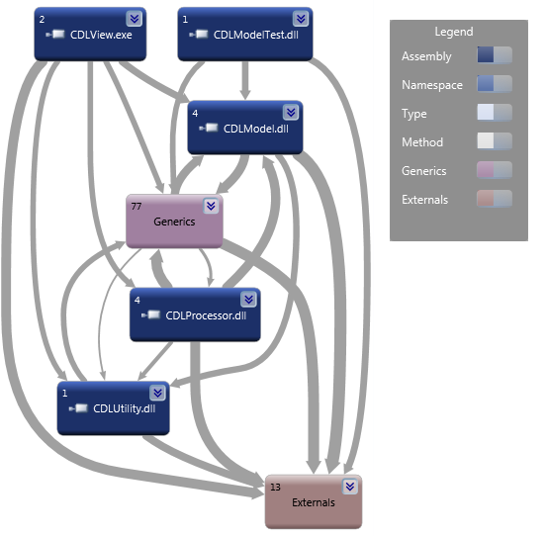
Assembly Dependencies

Slide 4
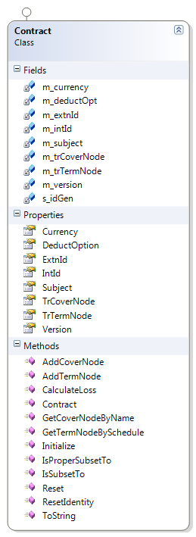
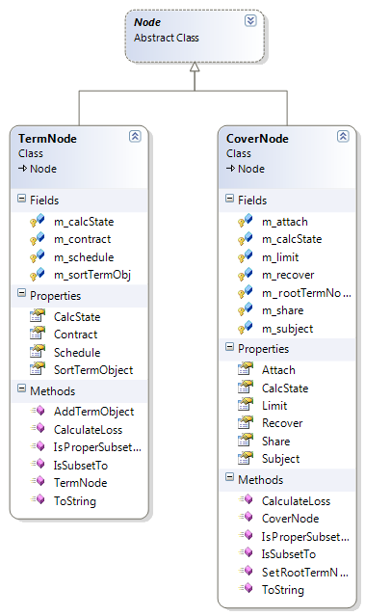
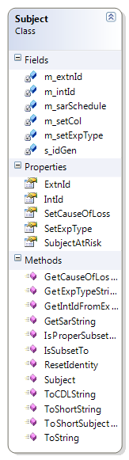
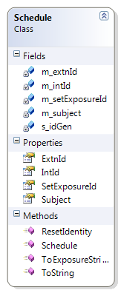
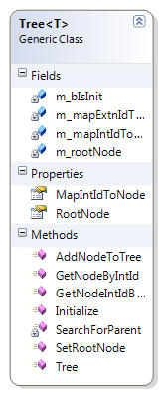
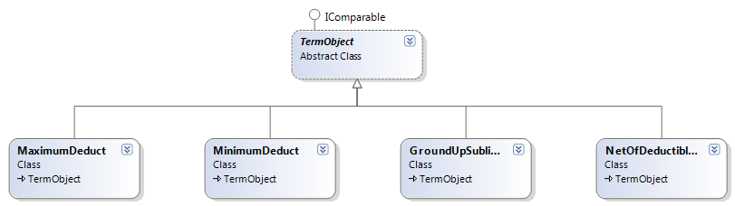
Primary Components of CDLModel

Slide 5
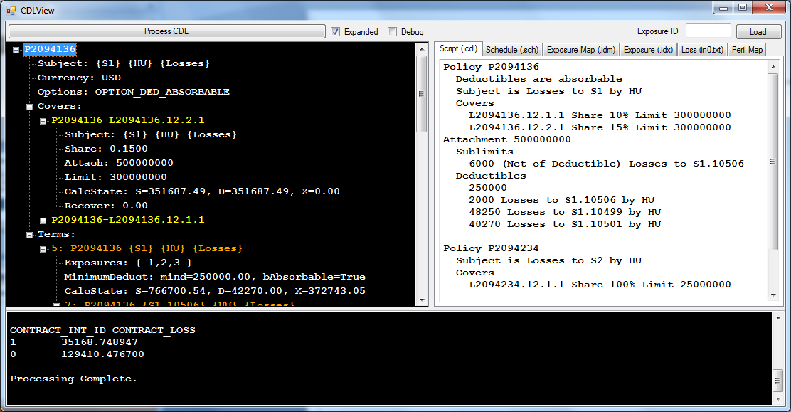
User Interface
Hierarchical View of Portfolio
CDL Editor
Migration Tool Interface
Optional Verbose Output of All Intermediate Calculations

Slide 6
External Dependencies and References
F# PowerPack
http://fsharppowerpack.codeplex.com/releases/view/45593
Visual Studio 2010 SDK
http://www.microsoft.com/download/en/details.aspx?id=2680
Powerpoint: “CDL based calculations & data formats”
http://sharepoint/ProdSolutions/NGFM/CM-CDL/Project%20Documents/CDL%20calc.pptx

